Slide 1


Is Love

Slide 2
Why it is cool
Reactive
Fast as f
No annotation and reflection bs
Starts in less than 1 second
Supports multiple languages (event non JVM)

Slide 3
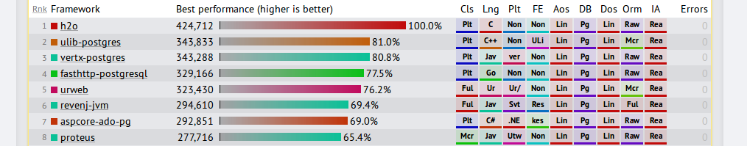
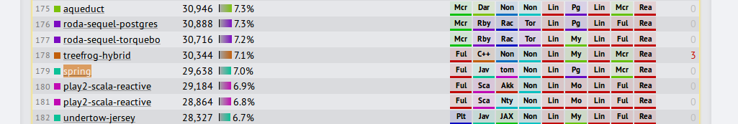
Why it is cool
https://www.techempower.com/benchmarks/

Slide 4
Core concepts
Nothing should block
Handles events using event loops (multi reactor)
Event loop calls handlers when it has data
Handlers get executed non concurrently

Slide 5
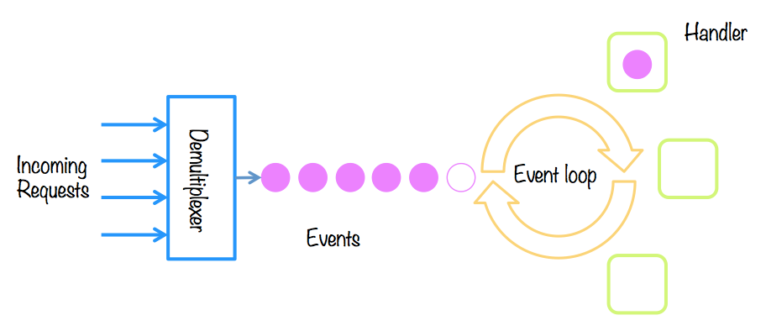
Forever looping

Slide 6
Starting Vertx
See
VertxIntro.java

Slide 7
Core code concepts
See
Car package, its very important
FuturesSimple.java
FuturesNested.java
FuturesComposing.java
Coroutines.kt

Slide 8
I need beans
Spring bean equivalent is Verticle
It can be run on separate processes or server instances and even in different languages (even JS)
However there is no magic
Unless you really like good old Spring,its super fast startup times, magic and cool patterns - then use Service Proxies

Slide 9

I need beans
See
Verticles.java

Slide 10

Communicating between Verticles
Event bus
Service proxies

Slide 11
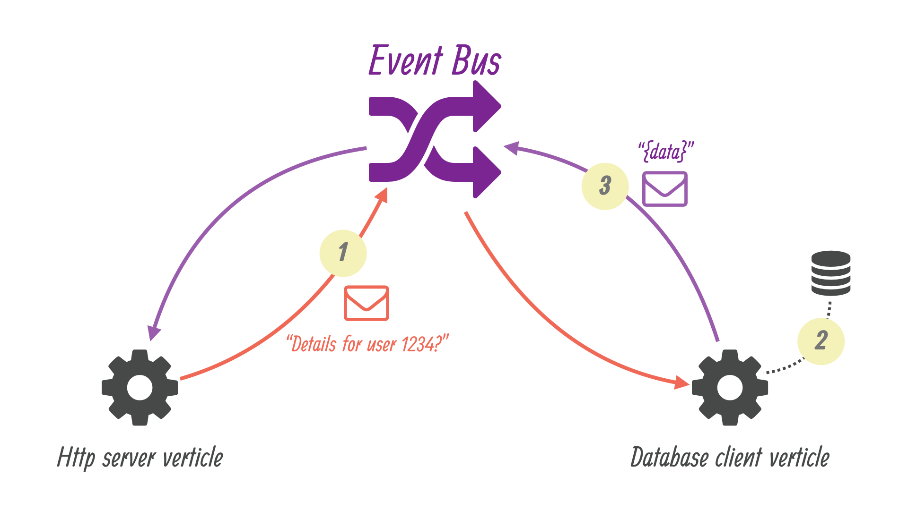
Communicating between Verticles

Slide 12
Communicating between Verticles
See:
SimpleEvents.java
ReplyEvents.java
VerticlesEventBus.java

Slide 13

This is taking too long, I need to REST
See:
Controllers.java

Slide 14
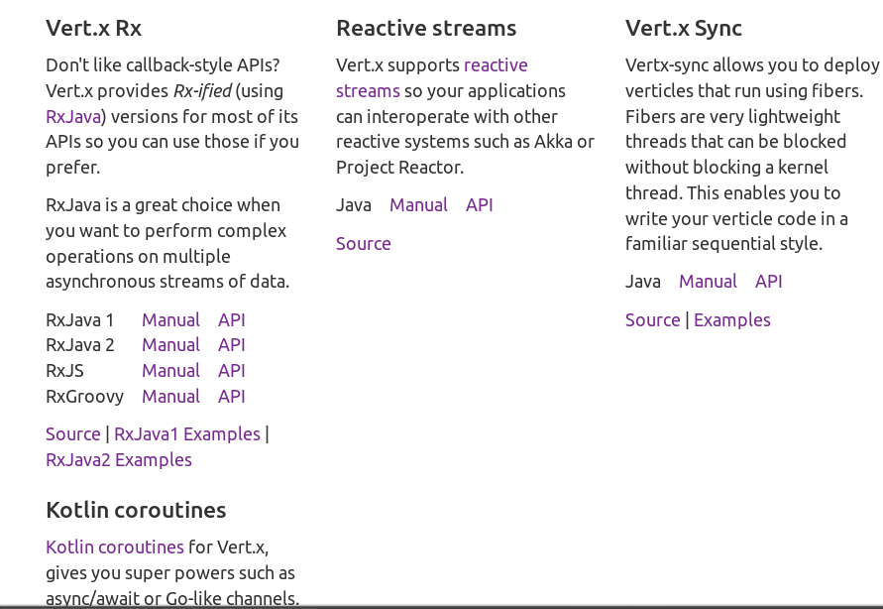
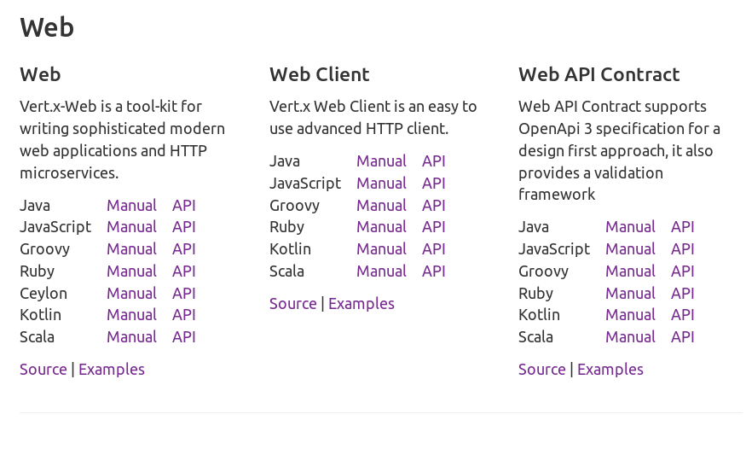
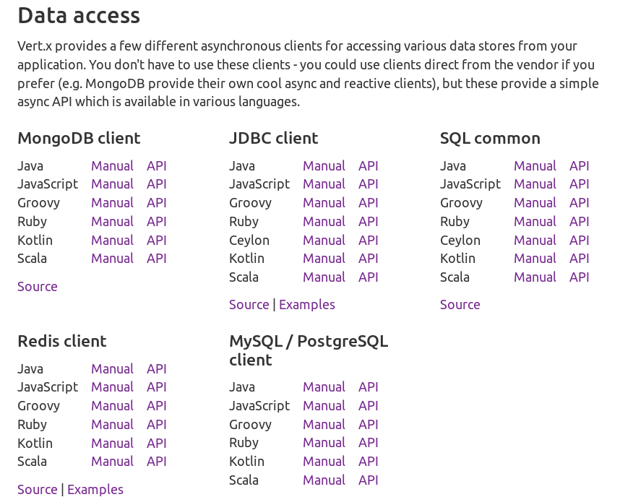
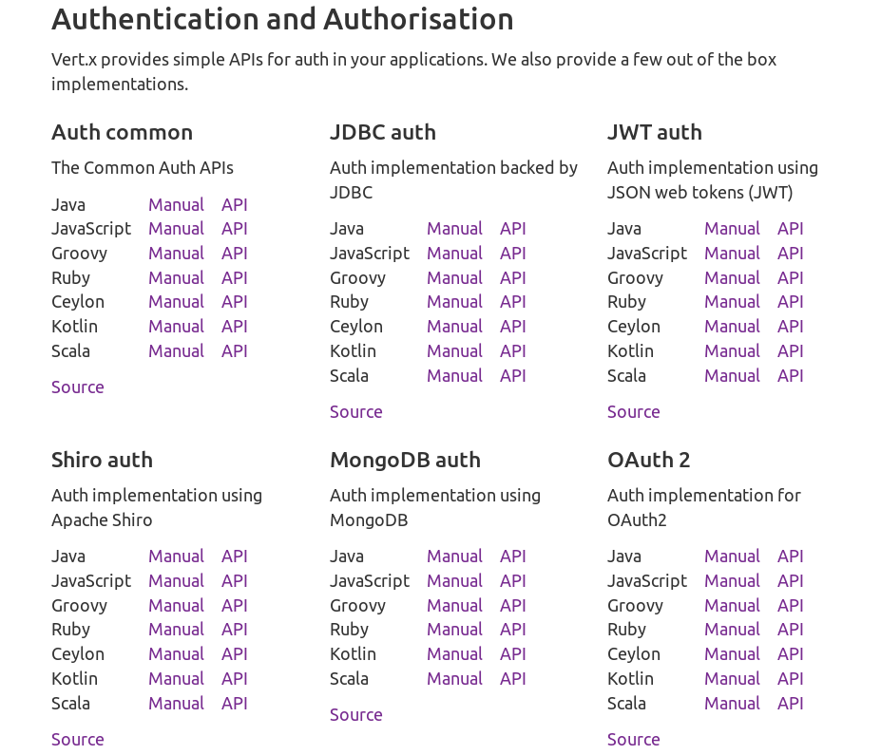
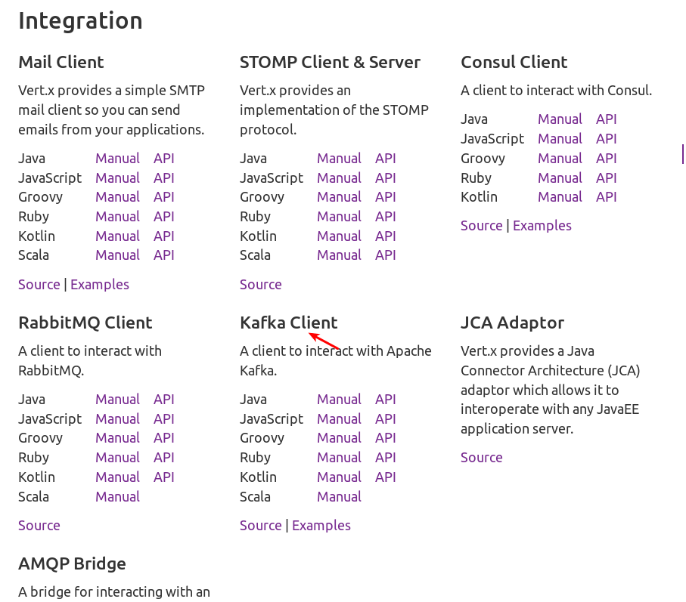
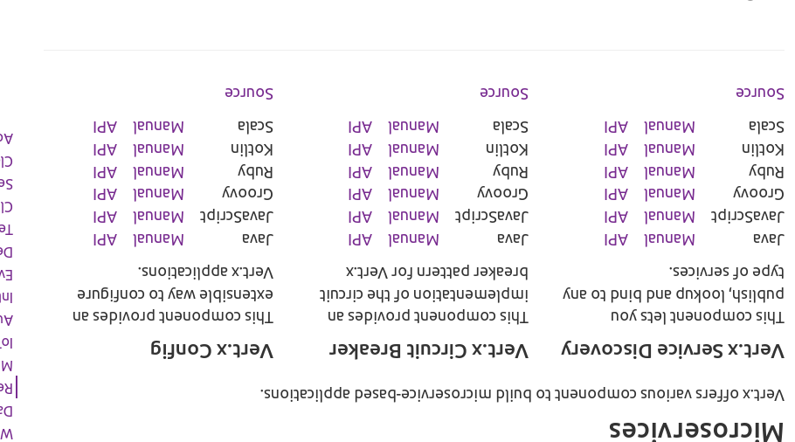
Well Spring has lots libs, what about Vertx?
Yes, lots them

Slide 15

We wont use Vertx cuz Spring rulez
Soon
https://github.com/getCUJO/doggert

